Slide 1
Measures & calculated columns
Measures & calculated columns

Slide 2
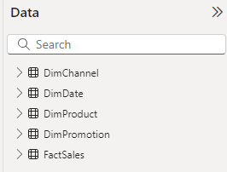
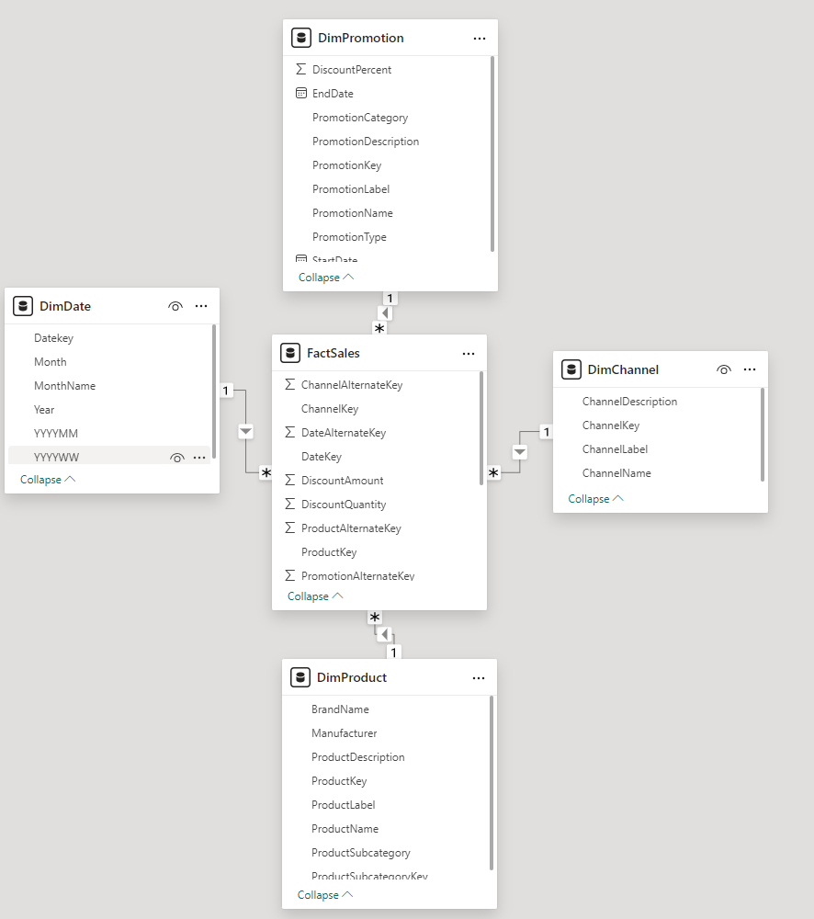
Measures and calculated columns
Note: This demo uses the FactSales table from the Sales database to demonstrate the difference between creating a calculated column and a measure.

Slide 3


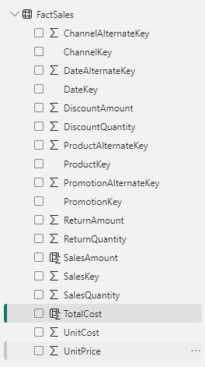
Measures and calculated columns
Create a column called SalesAmount = FactSales[SalesQuantity]*FactSales[UnitPrice]
Create a column called TotalCost = FactSales[SalesQuantity]-FactSales[UnitCost]

Slide 4

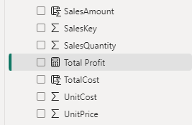
Measures and calculated columns
Create the measure Now at FactSales table level that calculate the total profit
Total Profit = SUM(FactSales[SalesAmount]) -SUM(FactSales[TotalCost])
Note the use of SUM function to aggregate data

Slide 5
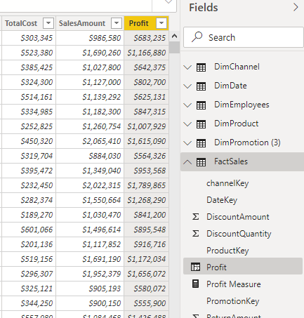
Measures and calculated columns
Note that the measure only takes into account aggregations example
Profit Measure = SUM( FactSales [ SalesAmount ] ) - SUM( FactSales [ TotalCost ] )

Slide 6
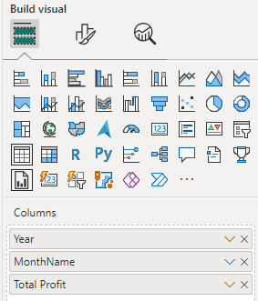
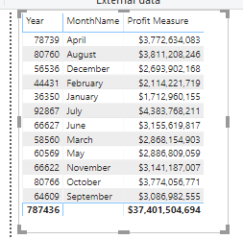
Measures and calculated columns
Note that the measure does not appear as a calculated column because the scope differs in the two cases.
Go back to the scene add a Table visualization and add Year and MonthName respectively as well as Total Profit to the Columns parameter and observe the visualization change

Slide 7
Thank you
Thank you

